Slide 1
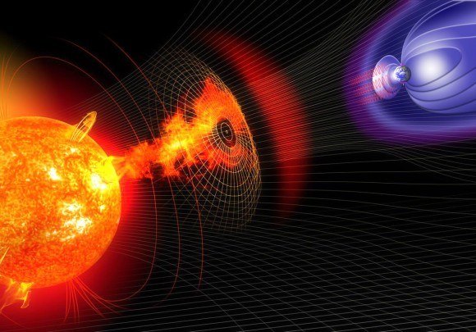
ARO 3191 Space Environments
S. Nanning
Last revised: 2021-01-21

Slide 2
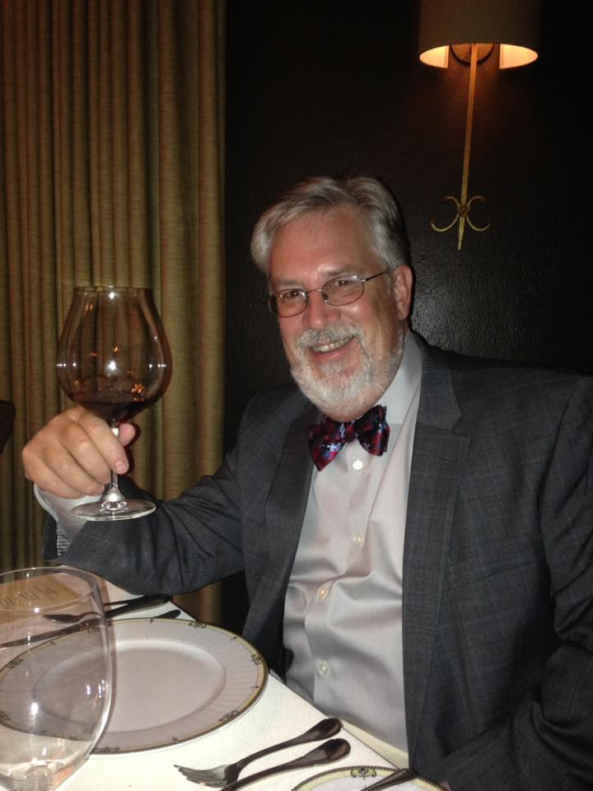

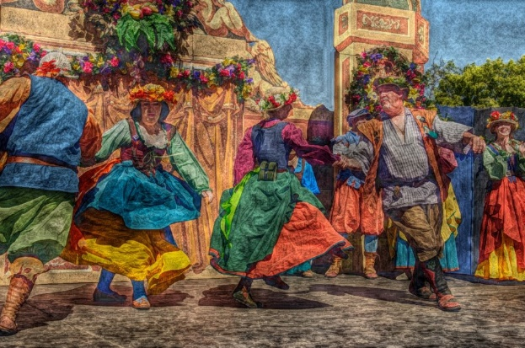

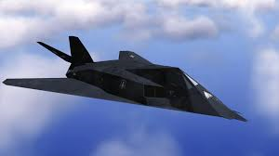
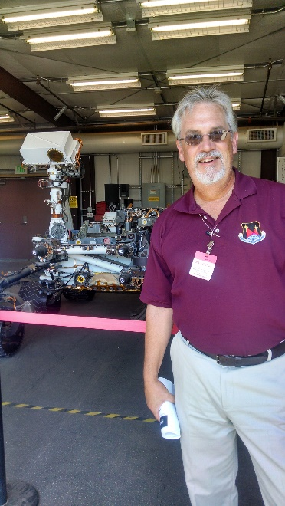
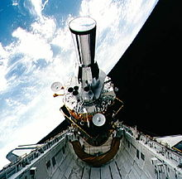
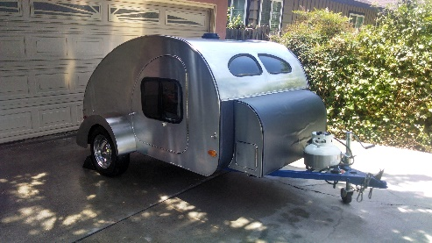
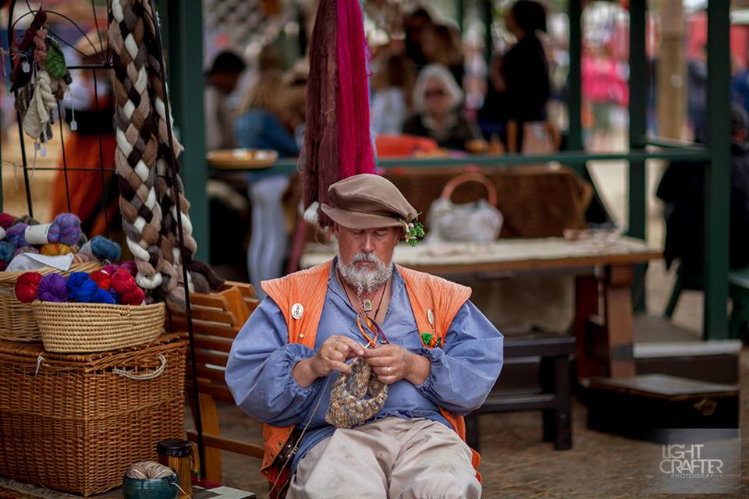
Who Is Steve Nanning?
Senior Engineering Fellow, Northrop Grumman,
Lecturer, Johns Hopkins & Cal Poly, Pomona
IAC Member, Cal Poly Aerospace, 2000-?
Graduate, Cal Poly Aerospace Eng, 1981
Masters Degrees, Nat’l Univ & USC
Over 18 Satellite Payloads on orbit
Rocket & Space Fan: From Project Mercury Dancer, Performer, Playwright
Renaissance Pleasure Faire
Wine Lover, Wood Worker, Photographer, Knitter
General Geek

Slide 3
Introduction
What you bring to the course
Knowledge
Enthusiasm
What you take away
A better sense of the Space Environment
Ability to adapt Space Environment concerns to Spacecraft Design & Mission Planning

Slide 4
Syllabus Contents
Read the whole thing!
Schedule inside of syllabus (very important, & subject to change)
Textbooks & References
Class organization & grading

Slide 5
Books — ARO-4990
Required
Copyrighted class lecture notes by the instructor
The Space Environment and its Effects on Space Systems, Pisacane, V: AIAA, 2016 (“Pisacane”
Recommended reference:
Space Mission Engineering: The New SMAD, Wertz et al, 2011, Microcosm (a.k.a. “SME”)

Slide 6
More Space References:
astronautix.com
16 GB USB that instructor can provide for a fee, or you can copy for free (if you don’t want the cool USB drive)

Slide 7
Course Philosophy
At its Core, this is an Astronomy course for Aerospace Engineers
Engineering focus will take precedence over classic Astronomical science
13 Week course; we’ll be lucky to get out of the Solar System

Slide 8
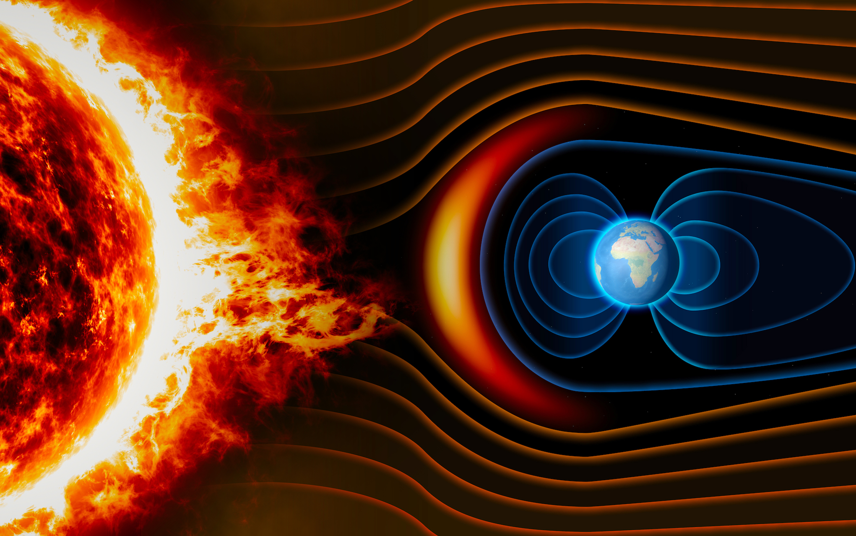
Space Environment Topics
Earth’s Atmosphere
Time Reference Systems
Neutral Environments
Solar System
The Sun & Solar Wind
Magnetosphere
Plasma Interactions
Gravitational Fields
Space Radiation
Space Debris & Spacecraft Contamination
Thermal Control
Useful Orbits
Orbital Rendezvous and other topics

Slide 9
My Expectations
You will attend ALL class sessions Attendance & lateness will be recorded & graded
You will bring a name card to place in front of you for each class, so I can learn your names (don’t take it personally, I just don’t do well with names – unless you really impress me, one way or the other!)
You may receive unannounced pop quizzes
The final is comprehensive and covers stuff you should know or learn in class
So: don’t skip class!

Slide 10
Courtesy
Turn off cell phones during lectures & formal activities
You are expected to be on time every day.
Show courtesy to your fellow students
Being on time is critically important during team phase
During presentations (mine & student):
Be polite & attentive
No computer or cell phone use

Slide 11
Class Format
Lectures by instructor on design topics, rough schedule in syllabus
Individual student presentations, 20 min or less, to class & instructor
Individual exercises (homework) turned in electronically to Blackboard
Activities & quizzes during class
Typical class: begin with student presentations, followed by instructor presentations on topic, followed by free time (if any time remains)

Slide 12
Schedule
Lecture topics & homework assignments in syllabus; lecture slides in notes, LV text
Assignments made are due at beginning of class SEVEN days later unless otherwise noted. Late work: not accepted without excuse.
Assignments may have written & oral components
Written part contains “shrunken” printout of oral presentation & technical calculations

Slide 13
Written Homework Grading Considerations
You will lose credit for the following flaws:
Failure to include all units or dimensions in calculations
NOT BEING LEGIBLE! Check your scan before uploading to BB (edit scans as photos may be very hard to read — next slide)
Obvious errors, typos (–1 point each: use spell-checker!), grammar boo-boos
Missing slide presentations
Other penalties at instructor’s discretion

Slide 14
Late Homework: Not Accepted
If not uploaded to Blackboard by the beginning of class, it will not be graded
If a “serious event” prevents you from attending class on time and presenting your homework, notice must be provided to the instructor no less than 30 minutes before class starts by email or telephone to my office number 626-812-2219 (the phone system records the time of received calls).
This also applies to quizzes.

Slide 15

Quizzes
4 – 6 during the semester
Announced the week prior
Have pencil & calculator always
Closed book & notes
No make-ups
Let me know when you cannot make class BEFORE you miss (phone or email)

Slide 16
Due at End of Semester
Put all of your presentations/homework on a USB drive (I can provide, or will return yours)
Put files into a folder labeled “lastname.firstname”
Device must be labeled with name(s) & date
Multiple students encouraged to use one USB
Provide to instructor no later than day of final
Used by Aerospace Dept. for accreditation review by Board of Engineering (ABET) to certify our program

Slide 17
Approximate Grading Recipe,
Homework assignments — 20%
Worst one dropped
Quizzes — 10%
Mid-Term exam — 25%
Closed book; note sheet & calculator OK
Comprehensive Final exam — 40%
Attendance, data drop, other factors — 5%

Slide 18
Grades
100% available
94% to 100% → A
90% to 93% → A-
86% to 89% → B+
81% to 85% → B
76% to 80% → B-
70% to 75% → C
60% to 69% → D
0 to 59% → F
NO CURVE

Slide 19
Recommendations
Set aside at least EIGHT hours per week for homework and studying
COME TO CLASS
Come to office hours if you have questions
Do your homework (on your own)
Come prepared to class:
Read upcoming works, go over slides prior to lecture
Write down questions

Slide 20

Any Questions?
Thank you!

Slide 21
Schedule
In syllabus
Put items in your calendar!
Late items or assignments will not be accepted

Slide 22
Earth’s Atmosphere
ARO 3191 Space Environments
Lecture #1

Slide 23
Earth’s Atmosphere
“All the Air that’s Fit to Breathe”

Slide 24
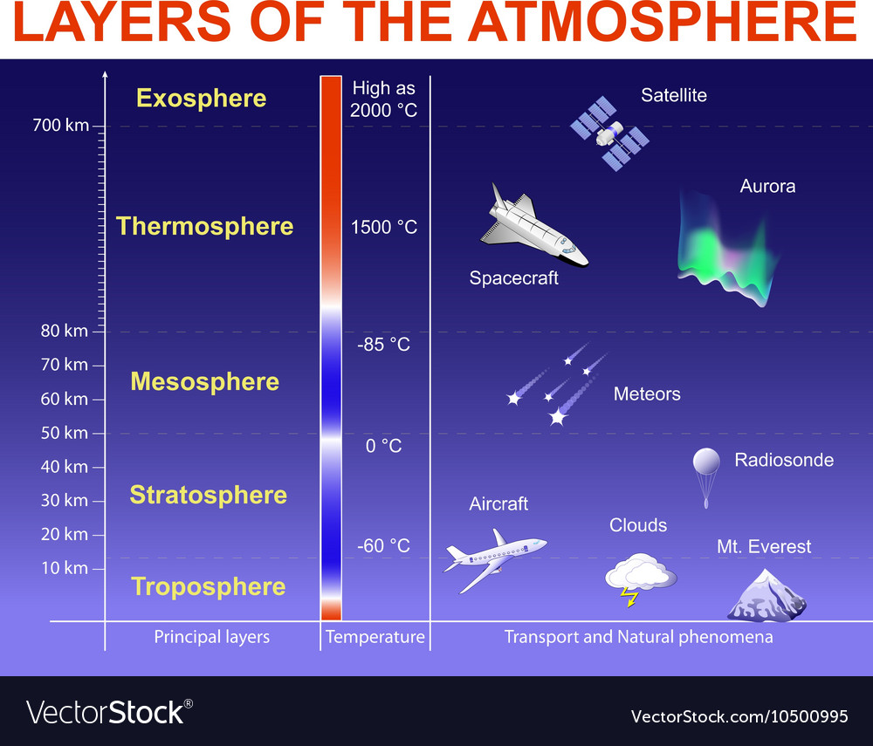
Earth’s Atmosphere
5 layers
Troposphere, stratosphere, mesosphere, thermosphere, exosphere

Slide 25
Earth’s Atmosphere
Troposphere
0-~11km
75% of atmosphere
Temp drops with altitude
293K to 223K @ 6.5K/Km: Lapse Rate
Density at top ~0.1 atm
Stratosphere
11-~50Km
Temp increases 223K – 270K due to UV
Ozone Layer 20-30Km
~24% of remaining atmosphere

Slide 26
Earth’s Atmosphere
Mesosphere
50-90 Km
Temp decreases 270K to ~180K
Atmospheric tides due to Sun/Moon caused upwelling from Stratosphere
Most meteoroids burn up here
Thermosphere
90Km to 400-600Km
Temp increases 180K to 700-1800K due to Solar Absorption
Very low density
Small energy changes can result in large temperature shifts
Contains Ionosphere and Auroras

Slide 27
Earth’s Atmosphere
Exosphere
Thermopause (400-600Km) to Interplanetary region
Very low-density molecular gasses
Temp is constant with altitude, varies due to Solar Activity
700-1800K
Ends at ~10,000Km; not well defined

Slide 28
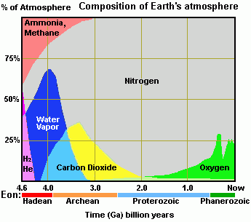
Earth’s Atmosphere
History
6 Atmospheric Epochs

Slide 29
Earth’s Atmosphere
Composition Stratification
Homosphere
Homogenous gas mixture below Turbopause
0-100Km
Uniformity of gases due to convection and winds
Heterosphere
Turbopause to Space
Composition varies as a function of Altitude
Heterogeneity is a result of a lack of mixing
Stratification by molecular mass

Slide 30
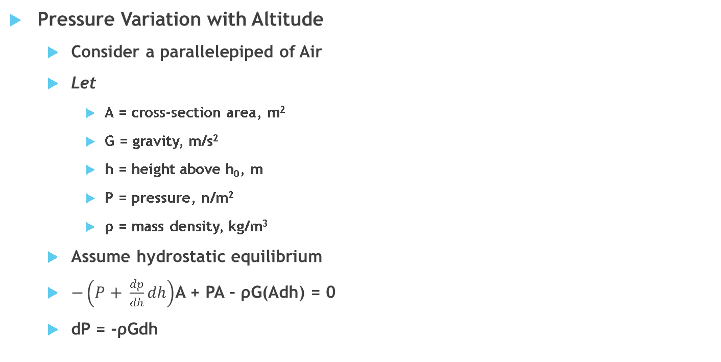
Earth’s Atmosphere
Pressure Variation with Altitude
Consider a parallelepiped of Air
Let
A = cross-section area, m²
G = gravity, m/s²
h = height above h₀, m
P = pressure, n/m²
ρ = mass density, kg/m³
Assume hydrostatic equilibrium
$−\left(P+ \frac{dp}{dh}dh\right)$A + PA – ρG(Adh) = 0
dP = -ρGdh

Slide 31
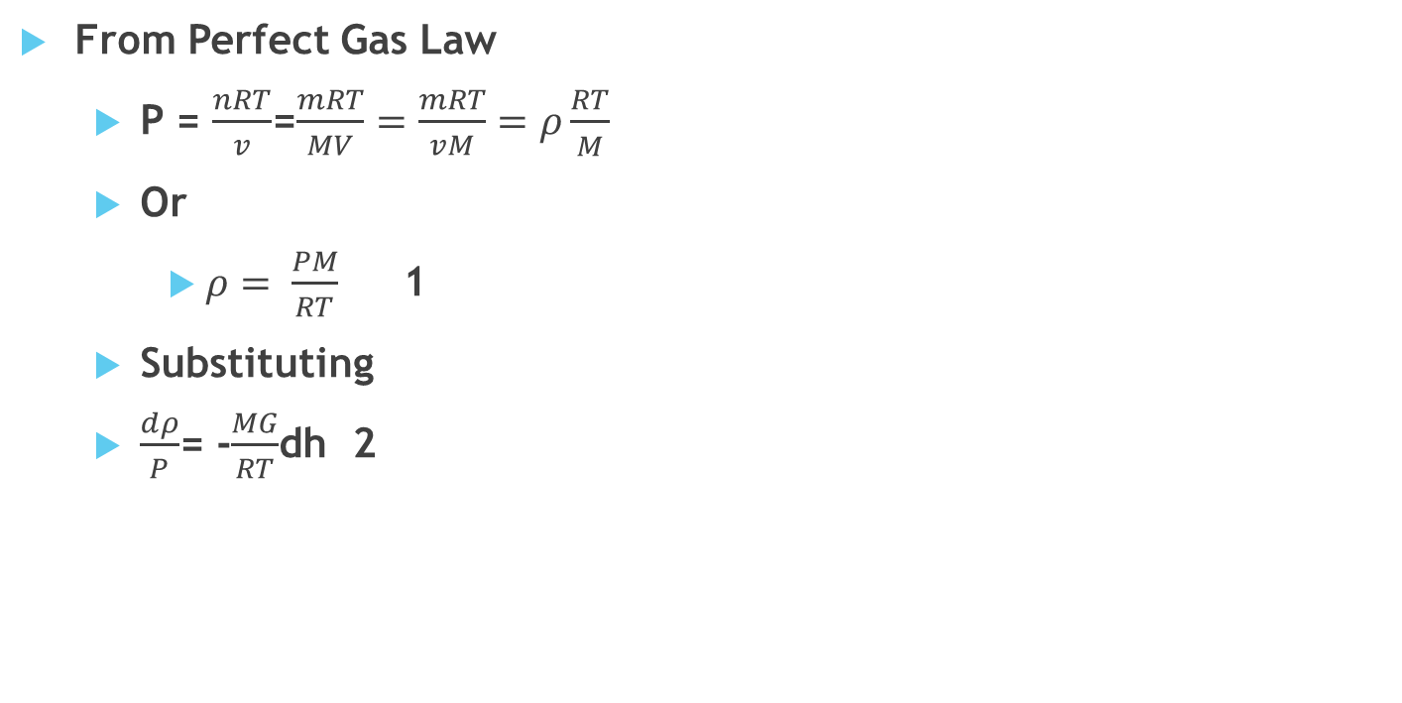
Earth’s Atmosphere
From Perfect Gas Law
P = $\frac{nRT}{v}$=$\frac{mRT}{MV}=\frac{mRT}{vM}=ρ\frac{RT}{\begin{aligned}M\end{aligned}}$
Or
$ρ= \frac{PM}{RT}$ 1
Substituting
$\frac{dρ}{P}$= -$\frac{MG}{RT}$dh 2

Slide 32
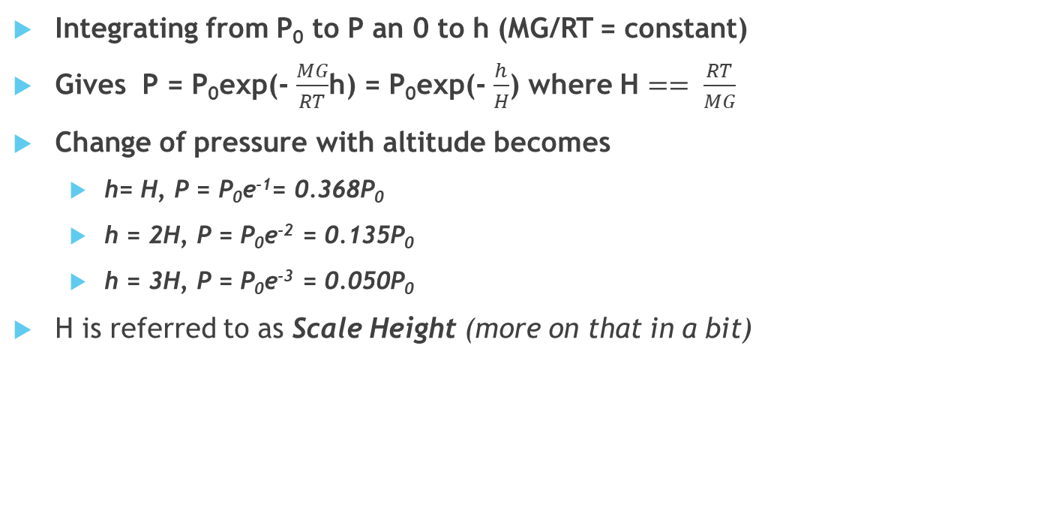
Earth’s Atmosphere
Integrating from P₀ to P an 0 to h (MG/RT = constant)
Gives P = P₀exp(- $\frac{MG}{RT}$h) = P₀exp(- $\frac{h}{H}$) where H $== \frac{RT}{MG}$
Change of pressure with altitude becomes
h= H, P = P₀e⁻¹= 0.368P₀
h = 2H, P = P₀e⁻² = 0.135P₀
h = 3H, P = P₀e⁻³ = 0.050P₀
H is referred to as Scale Height (more on that in a bit)

Slide 33
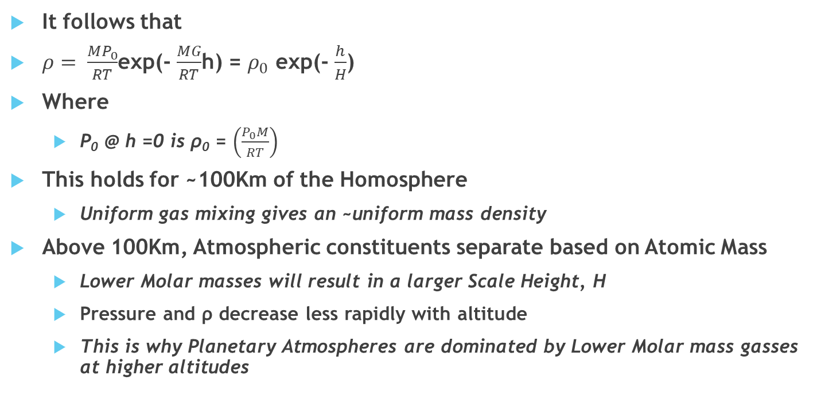
Earth’s Atmosphere
It follows that
$ρ= \frac{{MP}_{0}}{RT}$exp(- $\frac{MG}{RT}$h) = $ρ_{0}$ exp(- $\frac{h}{H}$)
Where
Ρ₀ @ h =0 is ρ₀ = $\left(\frac{P_{0}M}{RT}\right)$
This holds for ~100Km of the Homosphere
Uniform gas mixing gives an ~uniform mass density
Above 100Km, Atmospheric constituents separate based on Atomic Mass
Lower Molar masses will result in a larger Scale Height, H
Pressure and ρ decrease less rapidly with altitude
This is why Planetary Atmospheres are dominated by Lower Molar mass gasses at higher altitudes

Slide 34
Earth’s Atmosphere
Scale Height
Recall temp in Troposphere decreases with Altitude down to ~223K @ Tropopause
Scale Height, H, is a function of Lapse Rate & can be determined by differentiation w/r to height:
dH/dn = (r/Mg)(dT/dh)
Dividing by Scale Height gives:
dH/dh = (H/T)(d/T/dh)

Slide 35
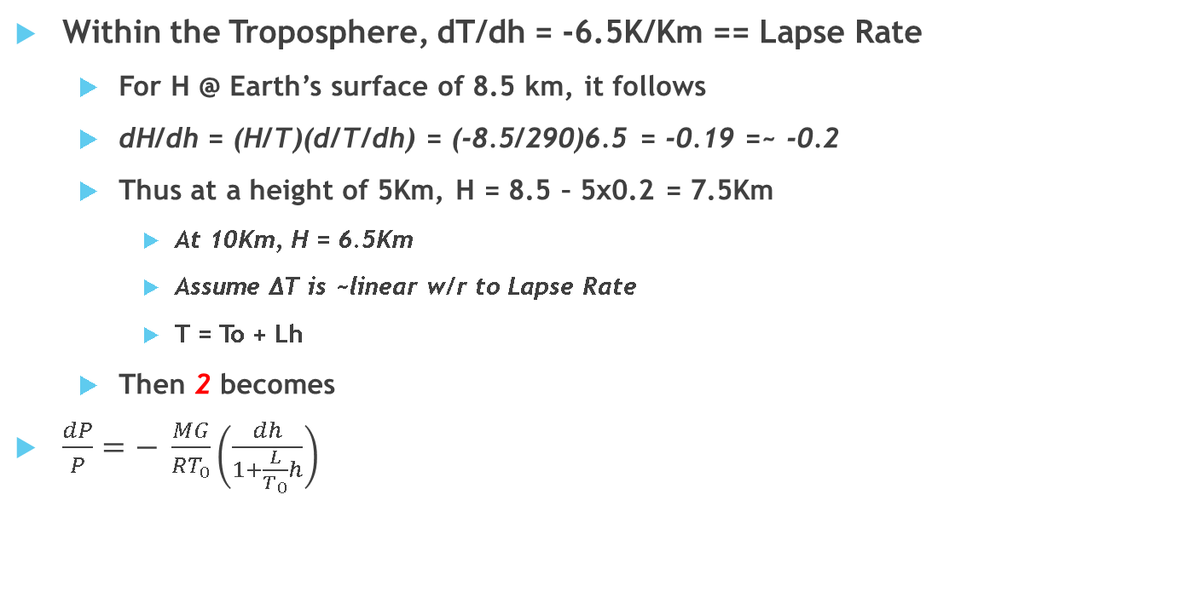
Earth’s Atmosphere
Within the Troposphere, dT/dh = -6.5K/Km == Lapse Rate
For H @ Earth’s surface of 8.5 km, it follows
dH/dh = (H/T)(d/T/dh) = (-8.5/290)6.5 = -0.19 =~ -0.2
Thus at a height of 5Km, H = 8.5 – 5x0.2 = 7.5Km
At 10Km, H = 6.5Km
Assume ΔT is ~linear w/r to Lapse Rate
T = To + Lh
Then 2 becomes
$\frac{dP}{P}=− \frac{MG}{RT_{0}}\left(\frac{dh}{1+\frac{L}{T_{0}}h}\right)$

Slide 36
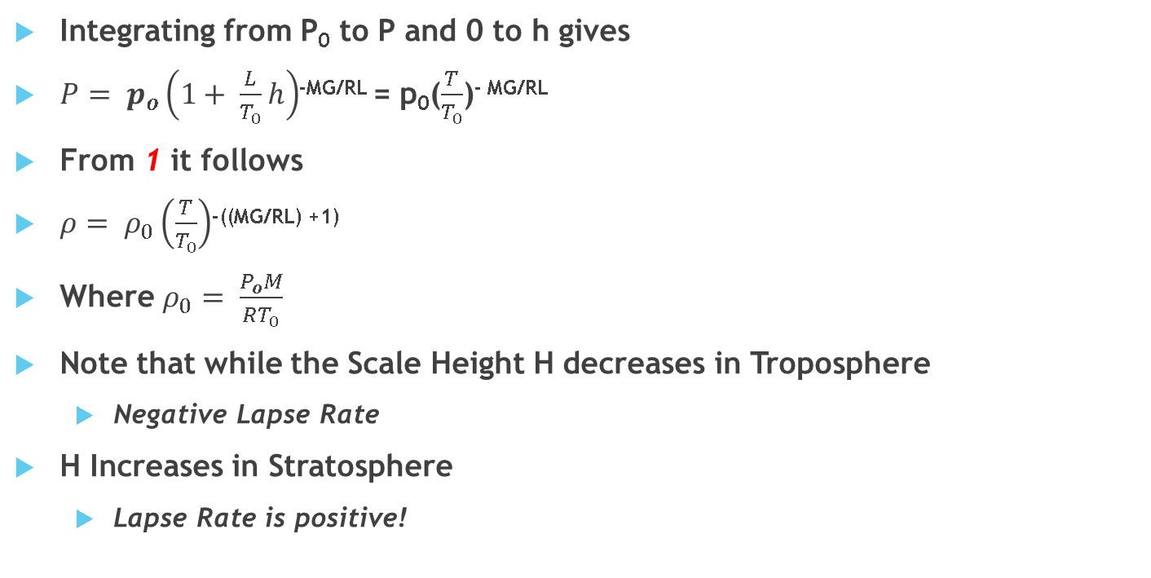
Earth’s Atmosphere
Integrating from P₀ to P and 0 to h gives
$P= p_{o}\left(1+ \frac{L}{T_{0}}h\right)$^{-MG/RL} = p₀($\frac{T}{T_{0}}$)^{- MG/RL}
From 1 it follows
$ρ= ρ_{0}\left(\frac{T}{T_{0}}\right)$^{-((MG/RL) +1)}
Where $ρ_{0}= \frac{P_{o}M}{RT_{0}}$
Note that while the Scale Height H decreases in Troposphere
Negative Lapse Rate
H Increases in Stratosphere
Lapse Rate is positive!

Slide 37
Time and Reference Systems
“We can’t know Where we are unless we know When we are”
– The Doctor

Slide 38
Time and Reference Systems
Earliest time references based on Sun and Moon
Synodic Motion of Moon = 29.53 days
Avg month is 30.44 days
Four phases 7.4 days each == week
Earth rotation gives us Day and Night == Year & Day
Standard Day = 24 hours = 1440 minutes = 86,400 seconds
Base 60 (Sexagesimal) is attributed to the Sumerians in ~3M BC
Basis for our 12/24-hour timekeeping
60 is a highly composite number
12 knuckles on fingers, 5 fingers on hand
Accuracy needed for Civil, Industrial, and Scientific purposes
Several Standards, based on Earth rotation, motion of Planets, and Electromechanical/Atomic devices

Slide 39
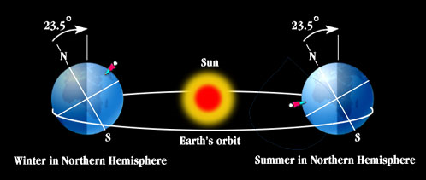
Time and Reference Systems
Celestial Motion
Term | Definition
Celestial Pole | Earth’s rotational axis
Ecliptic Plane | Earth’s Mean Orbital Plane
Ecliptic Pole | Axis perpendicular to Ecliptic Plane
Equinox | When Sun crosses Celestial Equator, Autumnal & Vernal
Equator | Imaginary plane normal to Earth’s axis of rotation
Obliquity | Angle btwn Ecliptic & Equatorial planes ~23.5°
Solstice | When Sun reaches highest & lowest points at Noon; 2/year
Year, anomalous | Period of 1 revolution of Earth about the Sun, perihelion to perihelion
Year, Sidereal | One revolution of Earth about the Sun wrt the stars
Year, Tropical | One revolution of Earth about Sun wrt Vernal equinox

Slide 40
Time and Reference Systems
Precession – Secular Motion of a Rigid Body
Free Precession
Angular Momentum is conserved
Angular Velocity changes as a function of Inertia
Polar Motion
Results from non-uniform mass distribution
The Earth wobbles a bit
Forced Precession
Results from gravitational forces & torques from Sun, Moon, and Planets

Slide 41
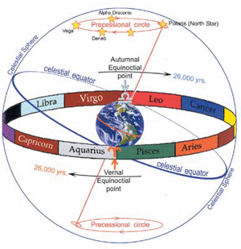
Time and Reference Systems
Nutation – Periodic Motions of a Rigid Body
Combination of Free & Forced
Free: Motions of Mantle & Core; water and ice redistribution
Forced: Torques from Sun/Moon on Equatorial bulge
Precession of the Equinox
Linear rate of ~50.288 arc-sec/year
25,772-year period or 1 degree/71.59 years
Welcome to the Age of Aquarius!

Slide 42
Time and Reference Systems
Precession of the Ecliptic
Slow orientation change
Principally due to Planetary gravity
Mainly Jupiter and Venus
Precession of the Equator
Forced Precession
Due to torques of Sun, Moon on Earth’s equatorial bulge
General Precession
Combined effect of Ecliptic and Equatorial Plane precession

Slide 43
Calendars
Advent Calendars are my favorite

Slide 44
Calendars
6 Principal calendar systems
Chinese, Gregorian, Indian, Islamic, Jewish, and Julian
Based on Astronomical cycles with defined sets of rules
Complex, as the cycles are not integer days, are not constant, and are not commensurable
Sidereal Year > Tropical year
Δ is ~avg precession of the equinox (25,772 yrs)
Δ ~ 0.014173 days/year
Parameter | Definition | Value (days)
Tropical Year | Equinox to Equinox | 365.2421897
Sidereal Year | Fixed Star to Fixed Star | 365.2563630
Anomalistic Year | Perihelion to Perihelion | 365.25964

Slide 45
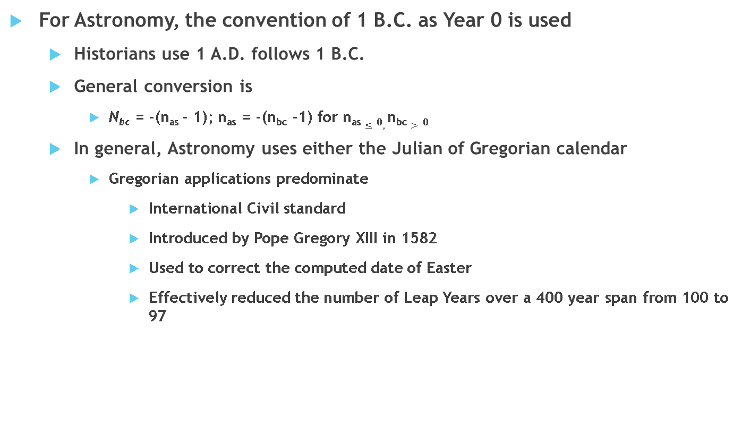
Calendars
For Astronomy, the convention of 1 B.C. as Year 0 is used
Historians use 1 A.D. follows 1 B.C.
General conversion is
N_{bc} = -(n_{as} – 1); n_{as} = -(n_{bc} -1) for n_{as} $≤0,$n_{bc} $>0$
In general, Astronomy uses either the Julian of Gregorian calendar
Gregorian applications predominate
International Civil standard
Introduced by Pope Gregory XIII in 1582
Used to correct the computed date of Easter
Effectively reduced the number of Leap Years over a 400 year span from 100 to 97

Slide 46
Calendars
Julian Day Number (JDN)
Number of integer Solar days
Day 0 = Noon @ Greenwich, Jan 1 4713 B.C.
Note that this is – 4712 A. S.
Based on intersection of 3 important calendar cycles
Indication number
Golden number
Solar number
Indication number: 15
Based on 15-year Taxation cycle introduced by Emperor Constantine
Golden Number: 19
Number of Tropical years that coincide w/integer number of synodic cycles of the Moon
i.e. every 19 years, the phases of the Moon fall on the same dates

Slide 47
Calendars
Julian Day Number (JDN) (cont’d)
Solar Number: 28
Number year cycle where Julian dates fall on the same days of the week
Combination of these three forms the Julian Period
7980 years (15 x 19 x 28)
All three had values of 1 on 1 January 4713 B.C.
Cycle will end in 3268 A.D.
JDN for Jan 1, 2000 is 2,451, 545.0 at noon

Slide 48
Calendars
Modified Julian Date (MJD) is # of days from Midnight, 17 Nov., 1858, where:
MJD = JDN – 2400000.5
MJD reduces the JDN to five digits for the period 1859-2130
Military applications often use a ‘J-date’ for planning/tracking
Simply the number day of the current year
Avg Julian Calendar year = 365.2500 days
Avg Gregorian Calendar year = 365.2425 days
Actual Tropical calendar year = 365.2422 days
Δ of ~ 27s/year with Gregorian Calendar

Slide 49
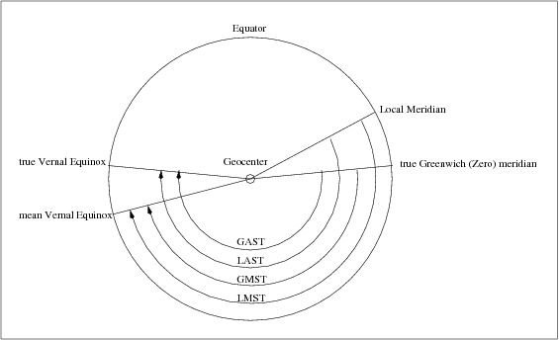
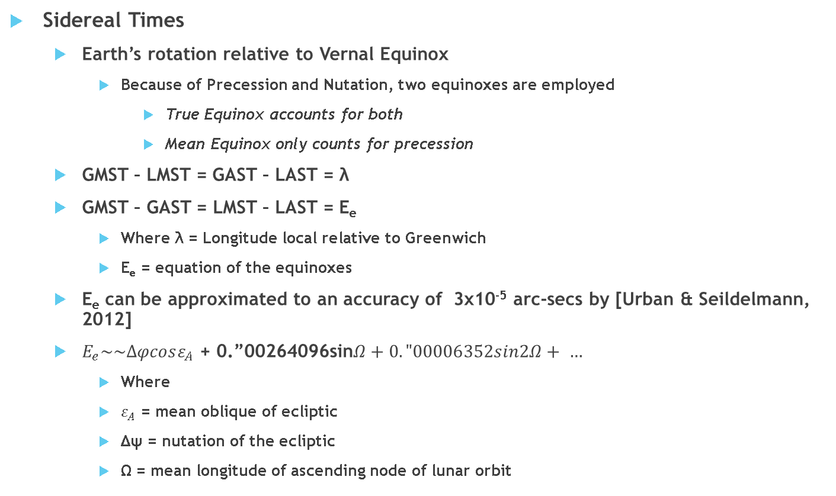
Calendars
Sidereal Times
Earth’s rotation relative to Vernal Equinox
Because of Precession and Nutation, two equinoxes are employed
True Equinox accounts for both
Mean Equinox only counts for precession
GMST – LMST = GAST – LAST = λ
GMST – GAST = LMST – LAST = E_{e}
Where λ = Longitude local relative to Greenwich
E_{e} = equation of the equinoxes
E_{e} can be approximated to an accuracy of 3x10⁻⁵ arc-secs by [Urban & Seildelmann, 2012]
$E_{e}\sim \sim ∆φcosε_{A}$ + 0.”00264096sin$Ω+0."00006352sin2Ω+ …$
Where
$ε_{A}$ = mean oblique of ecliptic
Δψ = nutation of the ecliptic
Ω = mean longitude of ascending node of lunar orbit

Slide 50
Universal Time
“Time is an illusion; lunchtime doubly so.”
-The Hitchhiker’s Guide to the Galaxy

Slide 51
Universal Time
Due to orbital motion, the length of a Solar day is (on average) 235.90947s longer than a Sidereal Day.
This mean Solar time is called Universal Time (UT) defined by r from [Urban & Seildelmann 2012] as
R(days) = 1.00273790934496866 + 5.8795412x10⁻¹¹T – 2.782x10⁻¹⁶T² – 2.50500x10⁻¹⁵T³ – 3.888x10⁻¹⁸T⁴
Where T = # of Julian centuries elapsed from JDN 245,154.0
UT (aka UT1) was formally known as Greenwich Mean Time

Slide 52
Universal Time
UTC (Coordinated Universal Time)
Initiated in 1961
Primary Civil Standard
Based on International Atomic Time (TAI)
UTC is TAI adjusted to approximate UT1
GPS is TAI that matched UTC in 1980, when the offset was 19s
GPS performs this offset when providing a time signal. Thus:
TAI – GPS = 19s
UTC = GPS + 19s – ΔAT
Where ΔAT is the current UTC to TAI offset

